Slide 1
Chapter 15: Analyze Telemetry to Better Anticipate Problems and Achieve Goals
Presented by Kendall Noble, Amy Zuniga, and Lauren Thorne

Slide 2
Introduction
How we can analyze telemetry to solve problems faster and cheaper then before
Using means and standard deviation to detect problems
How to add meaningful alerts to our monitoring system
Problems when our telemetry data has non-gaussian distribution
Using anomaly detection techniques
Case studies to show the use of these techniques

Slide 3

Netflix
Their challenge was finding sick nodes/servers
Used technique - outlier detection
This helped them find nodes that didn’t fit their normal pattern
Massively reduced effort and time
Notes:
Netflix is an example of how we can mitigate problems through telemetry
Outlier detection - when significant performance degradation causes abnormal running conditions
MAssively reduced effort and time to find sick servers and fix them, resulting in improved service quality

Slide 4
The simplest statistical techniques to analyze a production metric
Use standard deviations to detect when its significantly different than the norm
Create better alerts by focusing on outliers that matter
Use Means and Standard Deviations to Detect Potential Problems

Slide 5
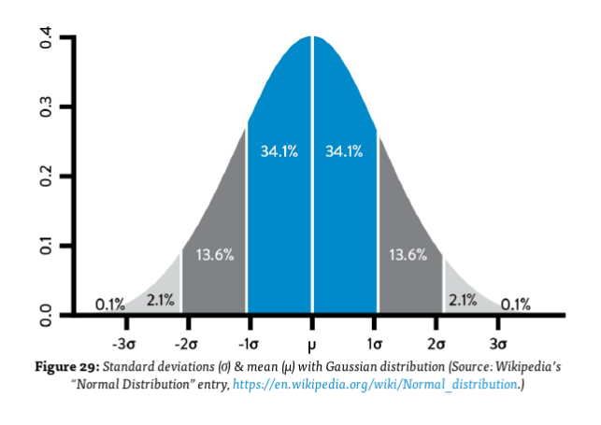
A common use is to inspect and alert
Example: unauthorized login attempts
Very valuable - no need to define a static threshold value
Standard Deviation and Mean with Gaussian Distribution
Notes:
Gaussian - normal or bell curve distribution
The middle line is the mean, and the first, second, and third lines represent the standard deviation
A common use of sd’s is to inspect for a metric and alert if it has significantly varied from the mean
Login attempts - set an alert if standard deviation is more than 3.
No need to define a static threshold value, which is impossible when tracking thousands of production metrics

Slide 6

Instrument and Alert On Undesired Outcomes
Analyze our most recent severe incidents, add indicators that would have predicted those
Configure alerting system to notify when they deviate sufficiently from mean
Repeat
Notes:
We don’t want to be bombarded with alerts that don’t help us. Instead we want alerts that help prevent outages and severe incidents
Example - if a server stops responding to requests, look at leading indicators that could have warned us earlier. Look at each level (Application, OS, dataase, network) Such as low space, increased load times, etc.
By repeating this process, we find problems ever earlier in the life cycle, resulting in fewer customer-impacting incidents. In other words, doing this prevents problems as well as enables quicker detection and correction

Slide 7
Problems that Arise When our Telemetry Data has Non-Guassian Distribution
Using standard deviations results in:
Nonsensical results (incl. Negative #’s)
Over & under alerting issues
1. Few actions that will fix issues
2. Causes hard to solve problems
Notes:
Using means and standard deviations to detect variance can be helpful
But using the techniques on many of the telemetry data sets that we use in operations won’t generate desired results
In data sets with ch- squared distribution
Dr. Nicole Forsgren: Non-Gaussian Distribution
When you compute the number of simultaneous downloads that are three standard deviations below the mean, you end up with a negative number, which obviously doesn’t make sense.”
Overalerting Operational engineers happens when the underlying data that we’re monitoring doesnt have gaussain distribution, causes problems bc these engineers will awake in middle of the night with limited actions they can take to solve the problem
Under alerting just as big as a problem, because customers could potentially discover problems before the engineers do, which in turn causes more problems that are harder to solve

Slide 8
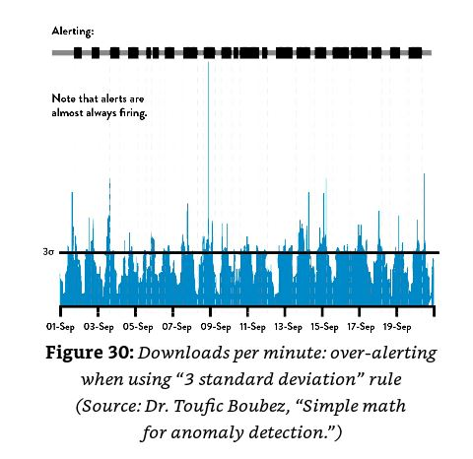
Constant ALERTS!
Graph shows how we have instances when the download count exceeds our three standard deviation threshold
Notes:
shows our number of simultaneous downloads per minute over time, with a bar overlaid on top.When the bar is black, the number of downloads within a given period (sometimes called a “sliding window”) is at least three standard deviations from the average. Otherwise, it is gray.

Slide 9
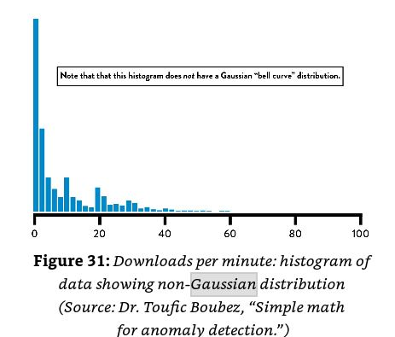
Non-Gaussian
Distribution
Pattern
Graph shows the frequency of downloads per minute.
Notes:
To confirm this, when we create a histogram (see figure 31) that shows the frequency of downloads per minute, we can see that it does not have the classic, symmetrical bell curve shape
the distribution is skewed toward the lower end, showing that the majority of the time we have very few downloads per minute but that download counts frequently spike three standard deviations higher.
.
Fortunately there are techniques we can use to detect anomalies in non-gaussian sets which we will look at with the next case study

Slide 10
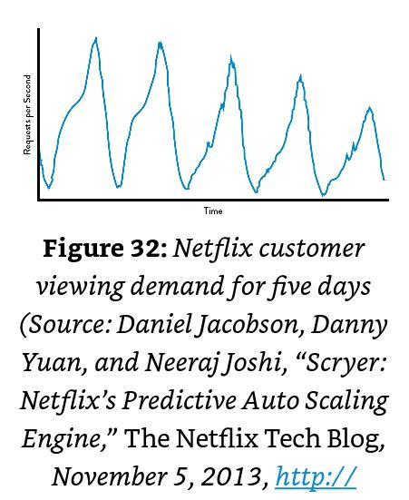
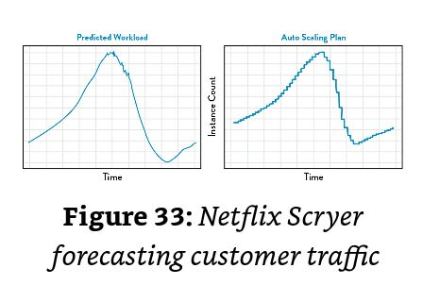
Case Study: Auto-Scaling Capacity at Netflix (2012)
Scryer
A tool Netflix developed
Increased service quality
Predicts what customer demands
Addressed 3 problems with AAS
Amazon Auto Scaling (AAS) 3 issues
Rapid spikes in demand
Removed too much to handle future demand
Factoring issues
Notes:
Based on historical usage patterns and provision the nesseca
AAS
Increases and decreases AWS compute server counts based on workload data
The first was dealing with rapid spikes in demand. compute capacity was often delivered too late to deal with spikes in demand.
The second problem was that after outages, the rapid decrease in customer demand led to AAS removing too much compute capacity to handle future incoming demand.
The third problem was that AAS didn’t factor in known usage traffic patterns when scheduling compute capacity.
Graph indicates Netflix’s consumer viewer pattern were consistent and predictable despite having non-gaussian distribution

Slide 11

Netflix’s Scryer
Used combination of outlier detections to dispose of spurious data points
Used Fast Fourier Transform (FFT) & Linear Regression to smooth the data
Preserved legitimate traffic spikes that recur in data
Benefits:
Netflix forecasted accurate traffic demand
Improved customer viewing experience
Improved service availability
Reduced Amazon EC2 costs
Notes:
Netflix decided to take advantage of the predictability in their non-gaussian data and

Slide 12
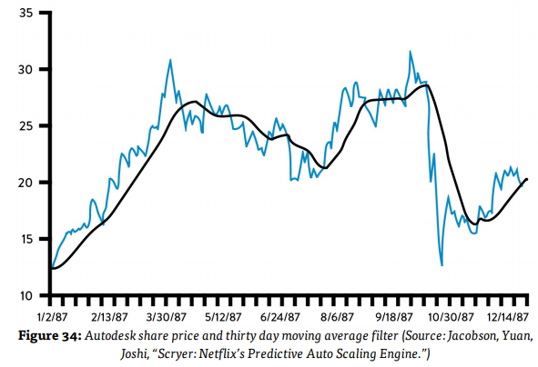
Using Anomaly Detection Techniques
Smoothing
Anomaly detection - find anything outside the norm
Use reliable statistical analysis software like Tableau or R
Use smoothing for graphs to see longer-term trends
Over times, patterns will emerge
Use departments familiar with data analysis to help forecast and detect anomalies in the data
Notes:
If our data doesn’t have a Gaussian distribution, we can still detect variances through anomaly detection. This looks for anything outside of the expected pattern.
Tarun Reddy of Rally Software has all metrics put in to a statistical analysis software called Tableau and has a statistically trained Ops engineer to help find variances early.
One technique is called smoothing like in the graph show. Each data point has a time stamp and involves averaging each point with all the other data within that sliding window. This smooths out the line to better see the longer-term trends.
Patterns can be expected over time, making it easier to detect anomalies and make forecasts. People that are in the Marketing or Business Intelligence departments that are knowledgeable in analyzing data can help with forecasting and improving anomaly detection.

Slide 13
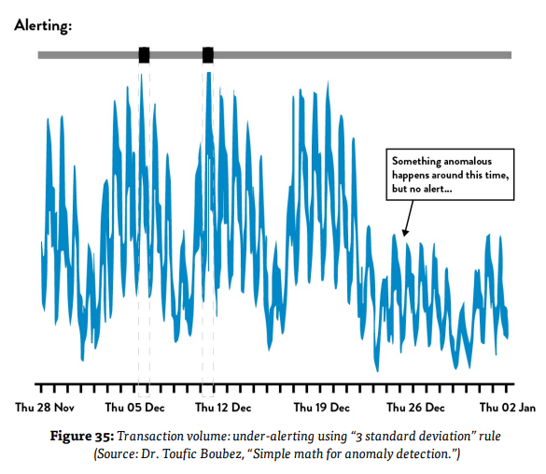
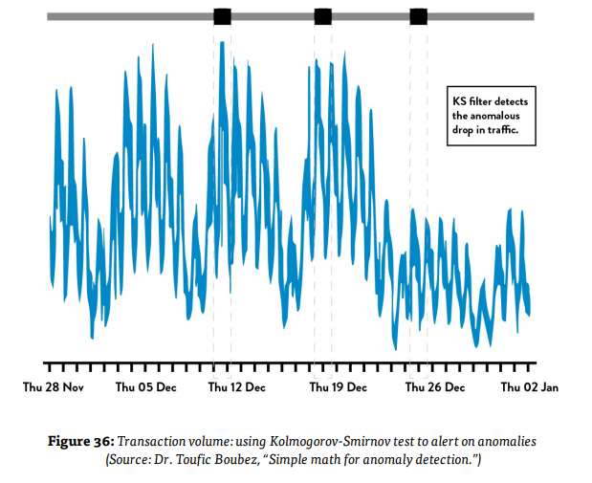
Case Study: Advanced Anomaly Detection
Kolmogorov-Smirnov detects more than standard deviation rule
Notes:
Another technique that can be used is the Komogorov-Smirnov test, used to find when data points differ significantly. These graphs show the same data of transaction volume for an e-commerce site, but the first one used the 3 standard deviation method and didn’t throw an alert when the traffic dropped off significantly. The Kolmogorov-Smirnov test in the second graph does highlight that dropoff from the expected pattern of transactions

Slide 14
Conclusion
Using any of the several statistical techniques covered can help find and resolve issues even faster
Results: System of work is safer and ability to achieve goals is increased
Notes:
We covered a handful of statistical techniques that can be used to find and resolve issues faster than ever. Analysing the statistical data then results in a safer system of work and an increased ability to achieve our goals.

